Slide 1
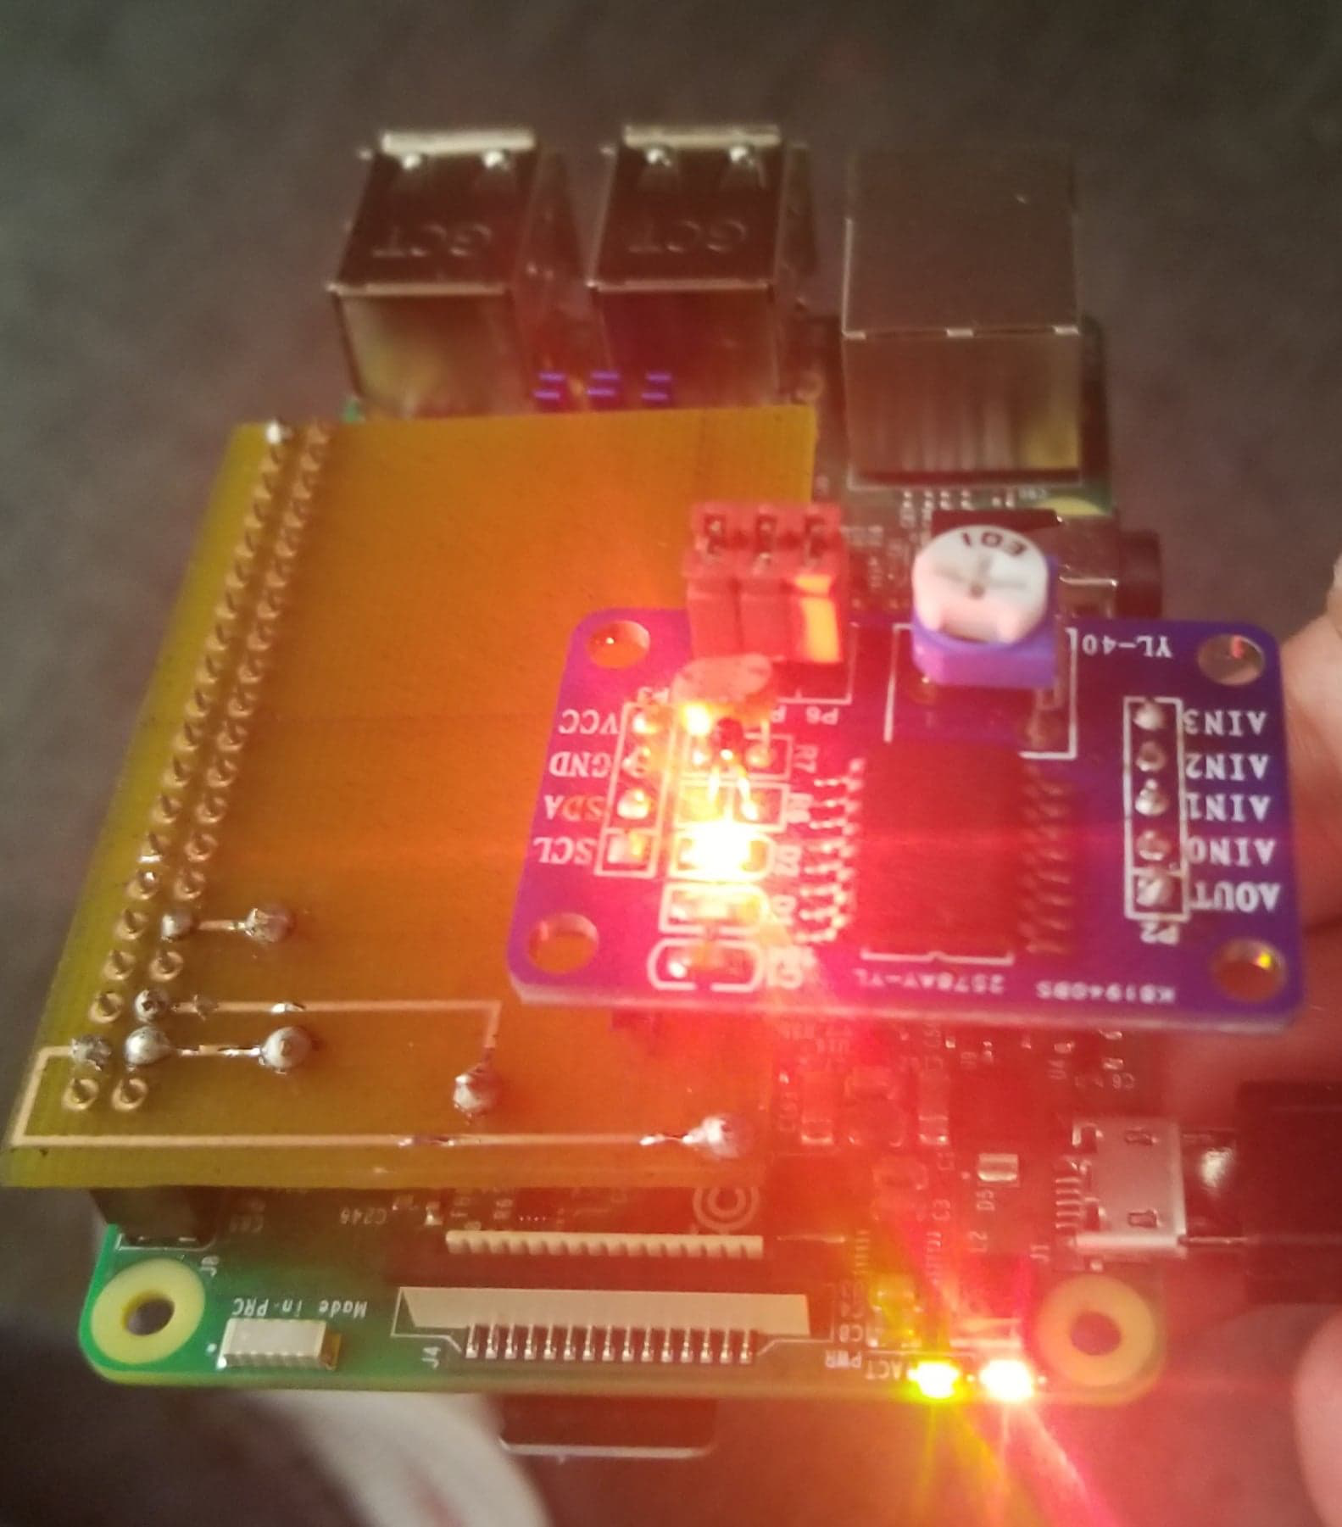
PCF 8591
By: Kogul Balasubramaniam
N01093997
CENG 317 – Hardware Production Tech

Slide 2
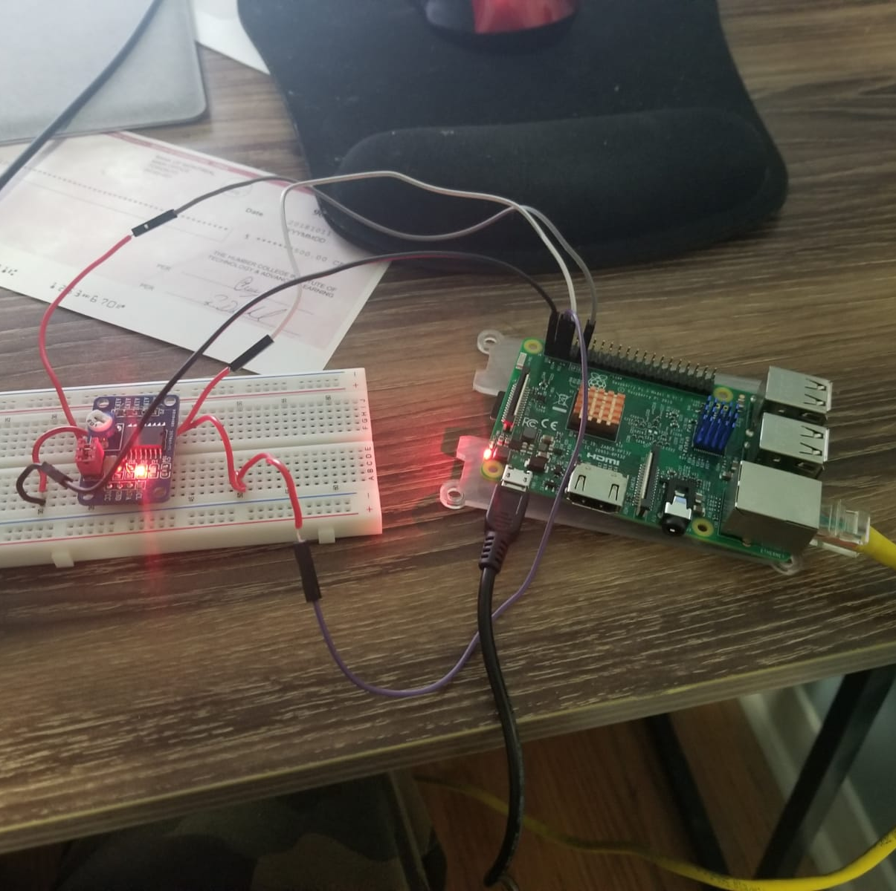
Proposal
The PCF 8591 is a module which works as a single DAC converter; as well as 4 ADC Converters. These being all usable through the I2C Bus.
The Pi itself can be used with just 3.3-5V, so for example a Raspberry Pi 3 development platform can be used.
Applications
The module contains a temperature sensor and a light sensor which can be used to get data on the current temperature and luminosity
The testing will show the use of the light sensor

Slide 3

Budget Plan
Parts | Source | Part Number | Unit Cost
Rpi 3 Kit | MakerSpot/Amazon | KRB0127 | $69.97
PCF 8591 | Sunfounder |  | $14.99
RJ45 Cat7 Ethernet Cable | Amazon | Hl-007826 | $8.99
USB 3.0 Gigabit Adapter | Amazon | AE3101X1 | $16.48
Breadboard/Parts Kit | Humber College |  | $100.00
Safety Glasses | Humber College |  | $5.00
Acrylic Case | Humber College |  | $7.00
Total |  |  | $222.43
Estimated Tax |  |  | $28.92
Grand Total |  |  | $251.35

Slide 4
Schedule
Task Name | Duration | Start | Finish
Testing Rpi Light Sensor | 1 hr | Tue 9/4/18 | Tue 9/4/18
Pick a Sensor | 30 mins | Tue 9/4/18 | Tue 9/4/18
Type up Proposal for Project/Gather Info about Project | 6 days | Tue 9/4/18 | Tue 9/11/18
Research on PCF8591 Sensor | 20 days | Tue 9/11/18 | Mon 10/8/18
Purchase Project Items | 7 days | Wed 9/19/18 | Thu 9/27/18
start working on Pseduo code assignment Wokring with first years | 6 days | Tue 10/9/18 | Tue 10/16/18
Implement Proejct on Breadboard Milestone of Project | 5 days | Wed 10/17/18 | Tue 10/23/18
Designing the PCB | 6 days | Tue 10/23/18 | Tue 10/30/18
Learining to Solder/Soldering PCB | 5 days | Wed 10/31/18 | Tue 11/6/18
Enclosure | 9 days | Thu 11/8/18 | Tue 11/20/18
Final Presenations | 6 days | Tue 11/27/18 | Tue 12/4/18
Final Outline of Build Instruction | 10 days | Tue 11/27/18 | Mon 12/10/18
My Schedule has slightly changed and altered throughout the weeks dues to some missed deadlines but completing the project happened on time

Slide 5
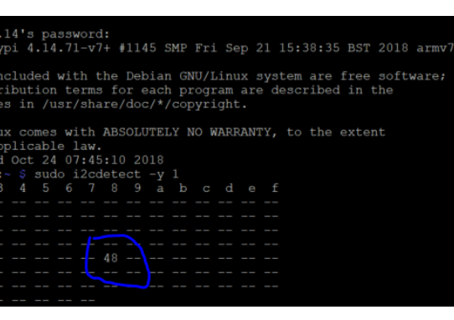
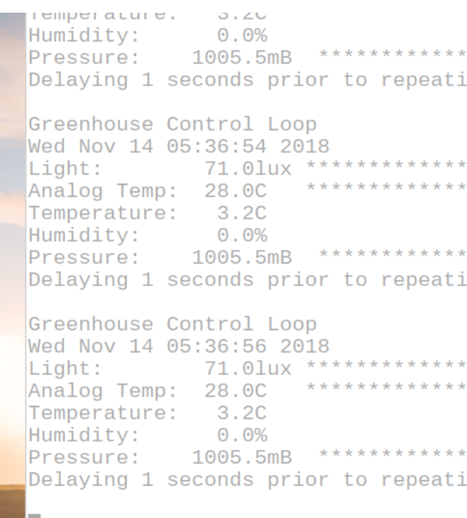
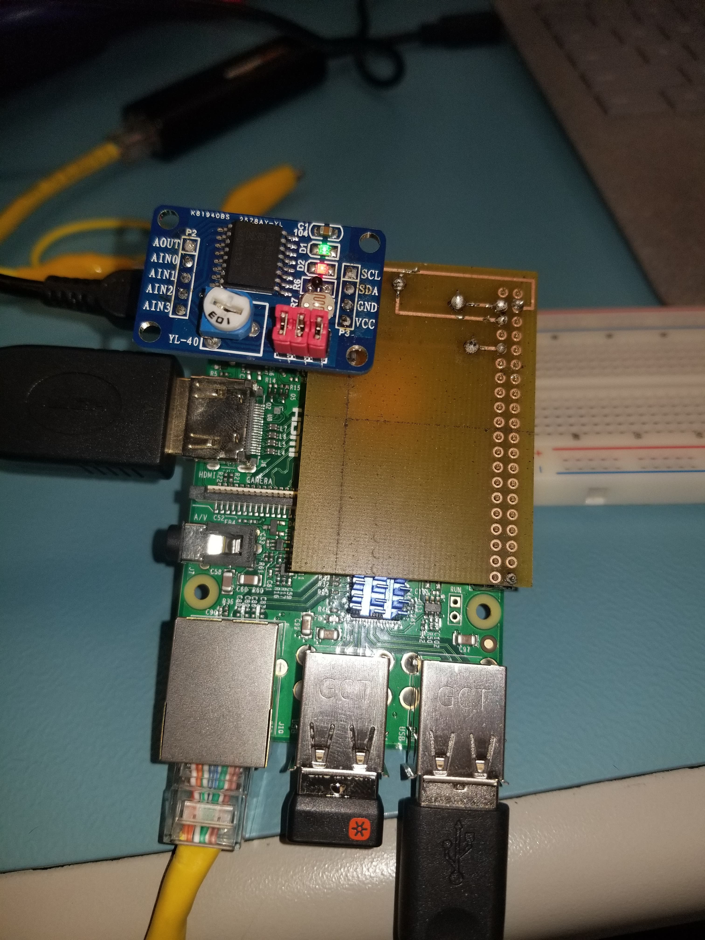
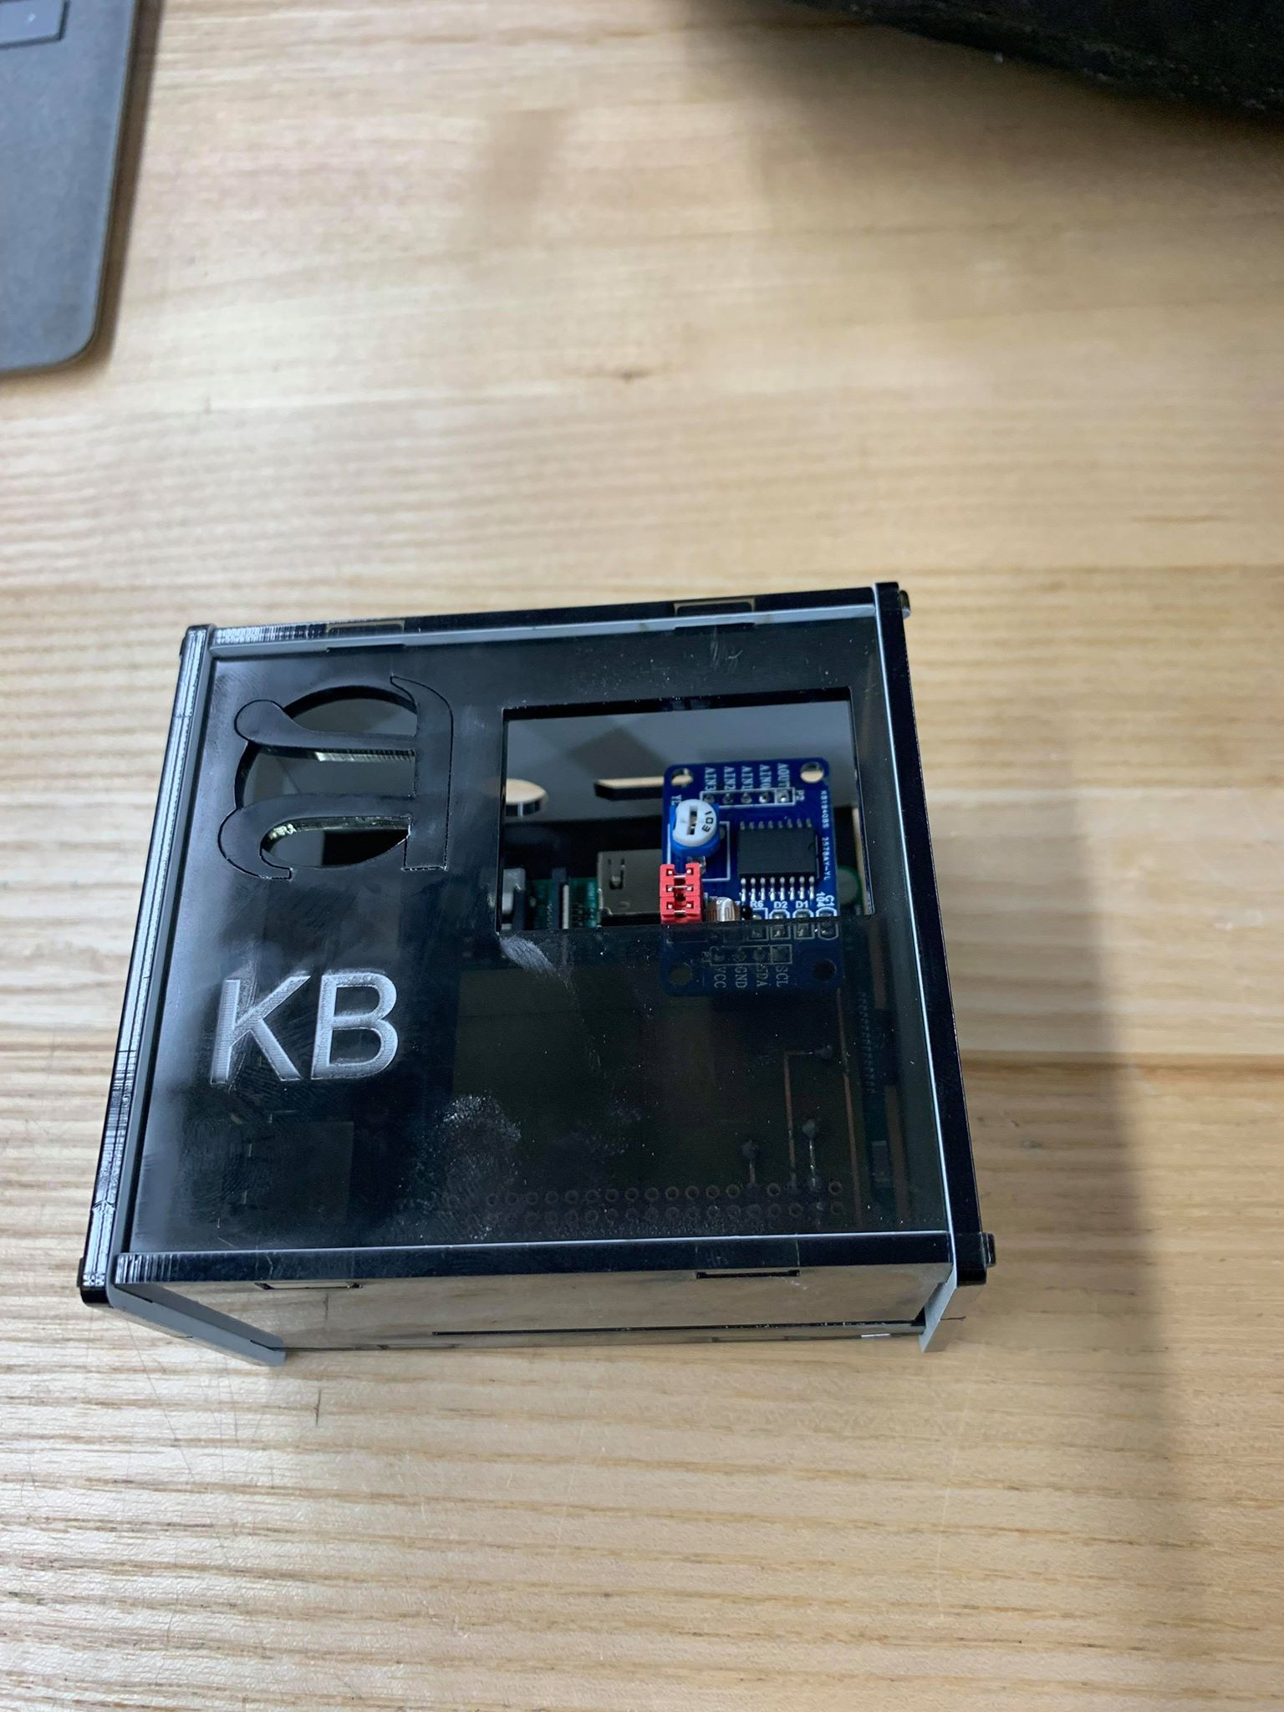

Screenshots of Working Code Detection and Enclosure

Slide 6
Course Knowledge from previous Courses Utilized in Project
Electrical Circuits – Basic Understanding of electrical components and theories
Programming Fundamentals – Introduction to C; Knowledge of basic programing; loops , if statements etc.
Technical C – Expanded knowledge of C programmed on Raspberry Pi using Remote Desktop Connection
Unix Internals – Basic info on how to traverse through the Unix shell; often used on Rpi 3
Embedded Systems - More In-depth Knowledge of microcontrollers and ICS

Slide 7
Thank You https://kogulb.github.io/KogulBCENG317Project/

